Slide 1
The Equivalent Force Couple System
Dr. Jacob Moore
Associate Professor of Engineering
Penn State Mont Alto

Slide 2
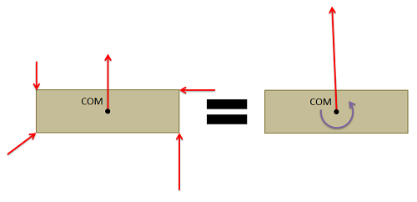
The Equivalent Force Couple System
Any set of forces, no matter how complex, has a single force and a single pure moment (or couple) that is statically equivalent to that original set of forces.
This force and moment, is known as the system’s equivalent force couple system.

Slide 3
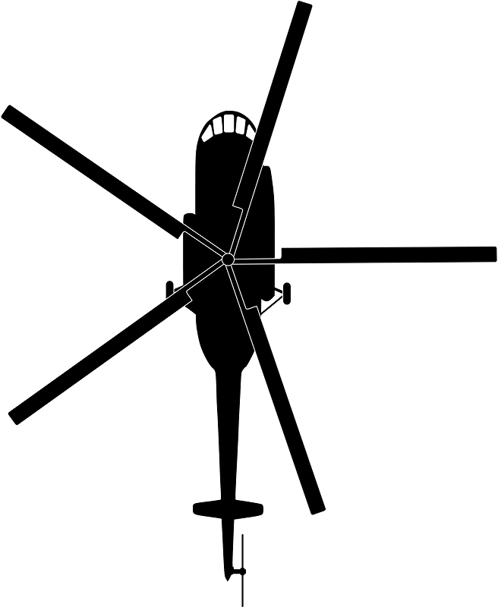



The Equivalent Force Couple System
By finding the equivalent force couple system, we can…
Gain clearer insight into what will happen to the body.
Simplify later analysis, particularly if we are designing something and will need to repeatedly model the impact of a set of forces.
$$F_{W}=300 N$$
55º
C
$$M_{B}=3 kNm$$
5 m
$$F_{R}=650 N$$

Slide 4



Finding the Equivalent Force Couple System
First, choose a point you want to find the equivalent force couple system about.
This can be any point, but the resulting force and couple you get will be valid only at that point.
$$F_{1}$$
$$F_{2}$$
$$F_{3}$$

Slide 5






Finding the Equivalent Force Couple System
Next you will resolve each force into a force and a couple about that point.
$$F_{1}$$
$$F_{2eq}$$
$$F_{2}$$
$$M_{3eq}$$
$$F_{3eq}$$
$$M_{2eq}$$
$$M_{1eq}$$
$$F_{1eq}$$
$$F_{3}$$

Slide 6


Finding the Equivalent Force Couple System
To find the force in the equivalent force couple system we now add all the force vectors.
To find the couple in the equivalent force couple system, we now add all the moments
We will be left with a single force and a single moment that is statically equivalent to the original set of forces.
$$F_{eq}$$
$$F_{2eq}$$
$$M_{3eq}$$
$$F_{3eq}$$
$$M_{2eq}$$
$$M_{1eq}$$
$$M_{eq}$$
$$F_{1eq}$$

Slide 7
Finding the Equivalent Force Couple System
As a shortcut to finding the equivalent force couple system we can also use the following process.
The equivalent force will be the sum of all the original force vectors.
The equivalent couple (moment) will be the sum of all the moments about that point
Including the moment exerted by each force and the pure moments exerted directly on the body.

Slide 8
Thanks for Watching
See other engineering mechanics videos and access the full tool at…

Slide 9
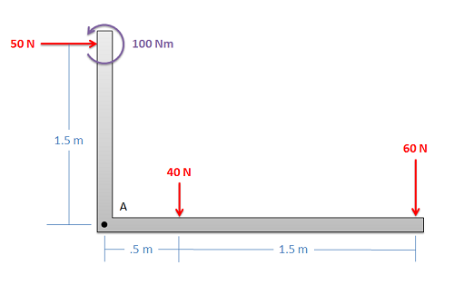
The Equivalent Force Couple System Worked Example
Find the equivalent force couple system about point A for the set of forces shown below.

Slide 10

Equivalent Force Couple System Worked Example
Find the equivalent force couple system about point G for the set of forces shown below.
5 ft
4 ft
G
2.5 ft
30 lbs
50 lbs
1400 lbs
600 lbs
800 lbs

Slide 11
Equivalent Force Couple System Worked Example
5 ft
4 ft
G
2.5 ft
30 lbs
50 lbs
1400 lbs
600 lbs
800 lbs

Slide 12

Equivalent Force Couple System Worked Example
An engine on an airplane fails mid-flight. The pilot tries to compensate using the rudder at the back of the tail. Find the equivalent force couple system about point G for the set of forces shown on the plane.
8m
12m
20m
50 kN
50 kN
50 kN
G
35m
8 kN

Slide 13
Equivalent Force Couple System Worked Example
8m
12m
20m
50 kN
50 kN
50 kN
G
35m
8 kN

